Slide 1

January 13, 2024

Slide 2

Preparing
Mid-Week Storm January 8-9
Internal Brief
EOC Cooperation
CCEMA
NWS
Notes:
Busy weather week; mid-week storm had little impact to the City;
In prep for 2nd storm; weather briefs sent to City staff per normal protocols;
CCEMA funnels forecasts and info to Local EMA's for prep

Slide 3

COSP EOC
Comprehensive Emergency Operations Plan
Updated 2023
22 Annexes Covering Specific Events
Annex H – Mass Care (Shelters)
Annex J – Flooding
Annex K – Severe Winter Storms
Notes:
Event prep is guided by EOP; EOP is structured to provide a general overview of risk with more specific Annexes for likely events;
Emergency Management Leadership Team involved as needed; Department heads or designees fill pre-assigned roles in the EMLT;
Usually FD, PD, DPW and Parks handle the majority of impact from events

Slide 4
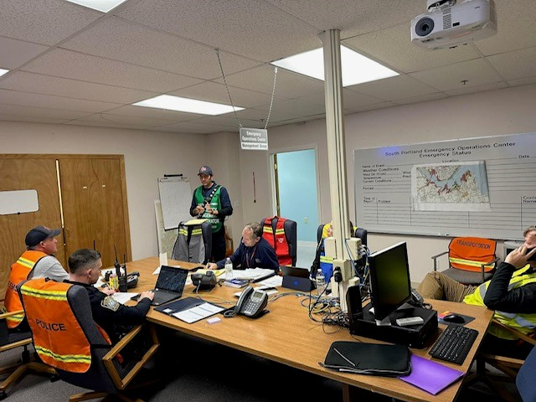
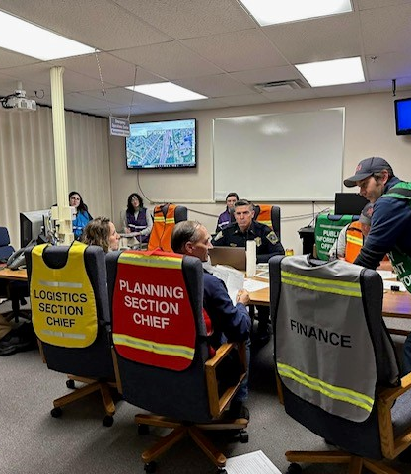
COSP EOC
Levels of Activation
Level 1 – Stand-by Mode
Level 2 – Monitoring Mode
Level 3 – Partial Activation (ICS)
Level 4 – Full Activation
Notes:
EOC is a physical place, but most events are handled virtually; Full EOC activations are rare, but are practiced.
For this event we did not open a physical EOC, but did coordinate between departments as the day unfolded;
We most frequently operate in the Monitoring Mode as most weather events require relatively routine cooperation between a few departments

Slide 5
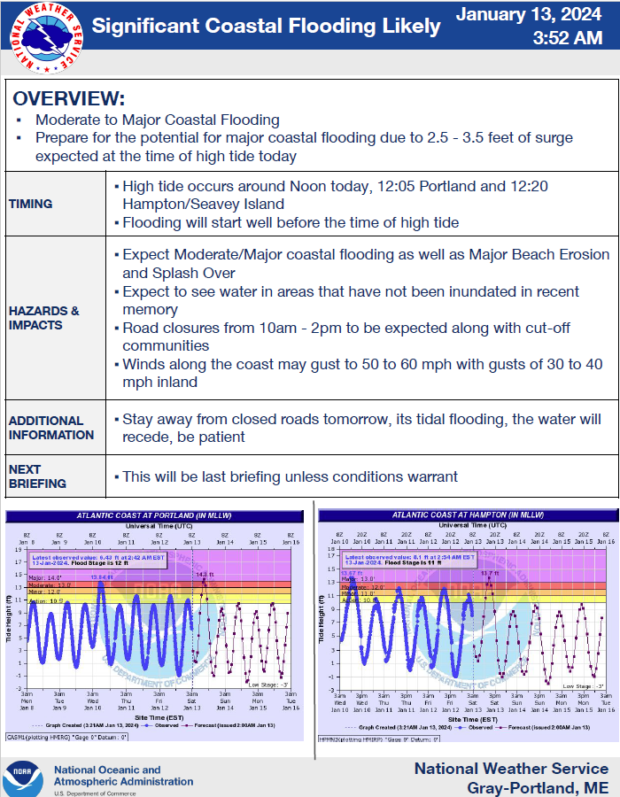
COSP EOC – Monitoring
SPFD – Fire Chief/EMA Director in contact with CCEMA
SPPW – Director in the City
SPPD – Shift Supervisor in contact with SPFD and SPPW
Communications Director had ready-to-go messaging
High Tide @ 12:06
Notes:
Prior to and throughout the storm COSPEOC was in real-time contact with CCEMA and other area EMA's virtually (common practice for these event)
DPW Director was in the City
SP Fire, PD and DPW share radio system and can easily contact via PRCC
Communications Director had pre-prepared messaging in case it was needed
Focused concern was on the tide and related impact; Tide reached a record high of 14.57 feet; previous record high was 14.17 feet (1978); records go back to 1912.

Slide 6
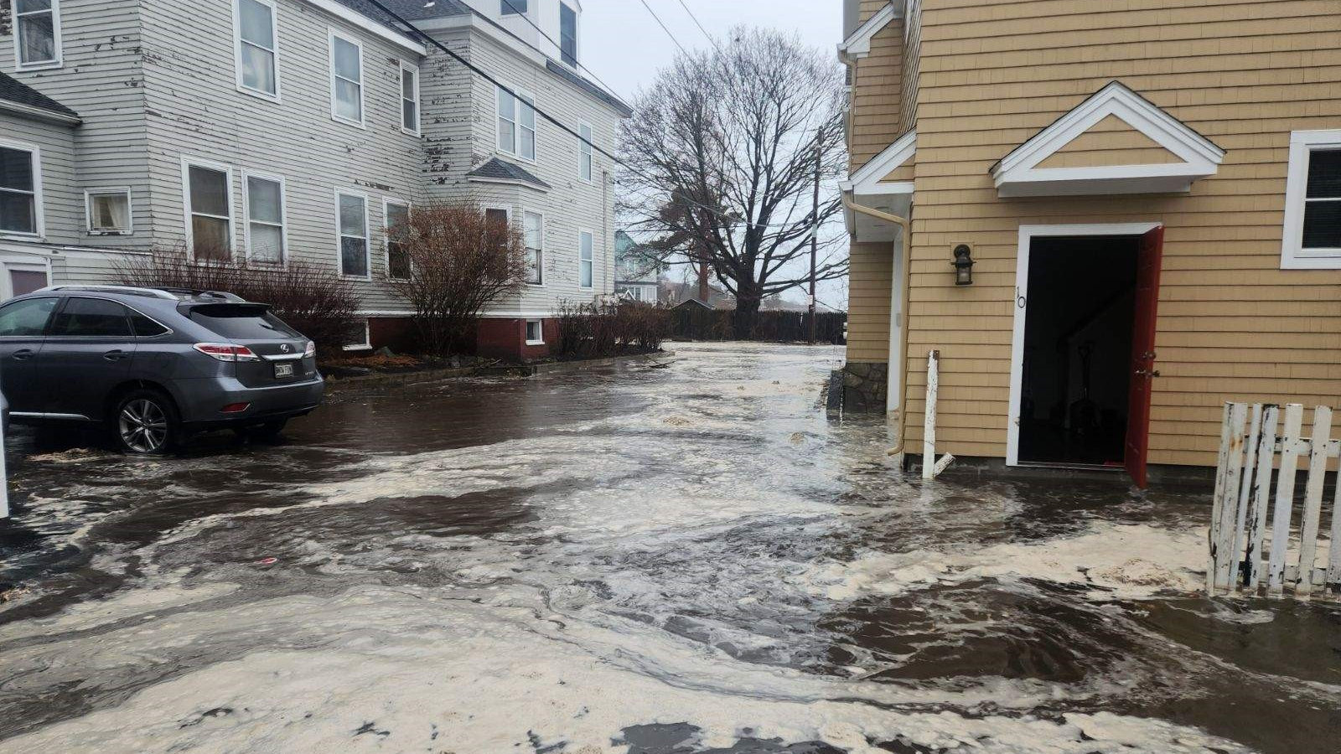
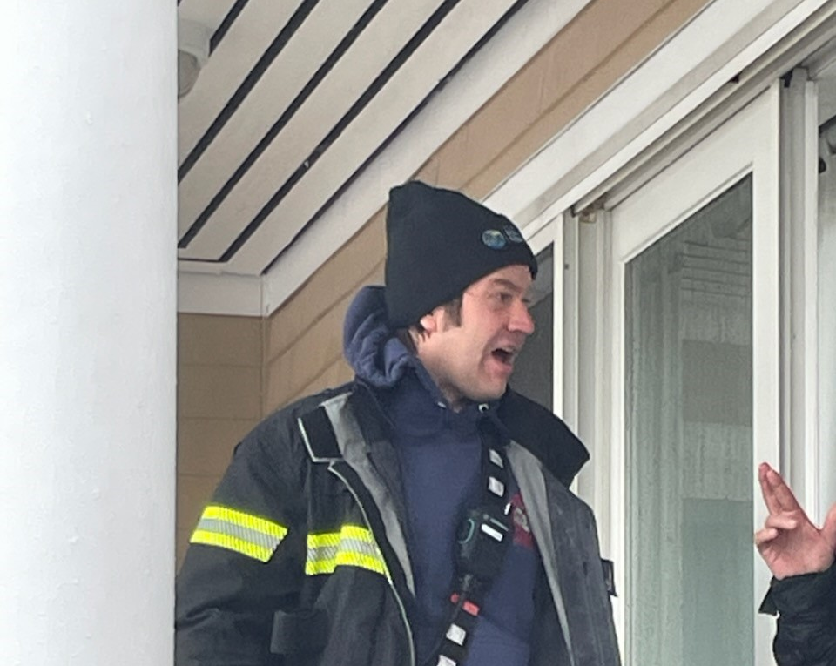
COSP EOC - Monitoring
Issues
Flooded basements – Several throughout the storm
Flooded Roads – Highland Ave @ SPHS & Nutter Road
Stranded vehicles – 2 vehicles stranded in roadways
Shoreline flooding – High Tide
Onlookers – Several areas were too dangerous for people
Notes:
Most FD responses were "run-of-the mill" water problems;
We did have 2 vehicles that tried to drive through flooded roadways and got stranded
Extend of the shoreline flooding was unusual.....normal high tide, astronomical high tide, surge
Onlookers at Fishermans point and other areas presented problems for First Responders

Slide 7
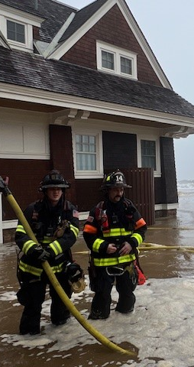
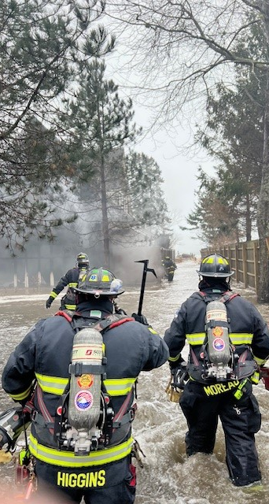
"Normal" Operations
2 Mutual Aid Fires
Car accident on T-Pike
Several Fire Alarms & Medical Calls
Notes:
In the 24 hours of 1/13/24, SPFD responded to 28 emergency calls, 11 of which were directly storm related and almost all were on the East End of the City;
Both Call Companies were activated for the hours during the heigh of the storm and assisted with several incidents and did door-to-door checks in the Willard Beach area

Slide 8
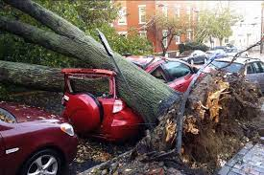
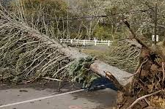

October 2017
Comparable Storm
More damage city-wide
Accompanied by power outages
Notes:
In comparison, we have has other similar storms that have had a wider area impact; "Halloween Storm" in 2017 was similar in wind direction; but did not have the accompanying astronomical high tide combined with storm surge;
SPFD had more than twice the CFS during the October 2017 storm as we did on January 13, 2024.

Slide 9
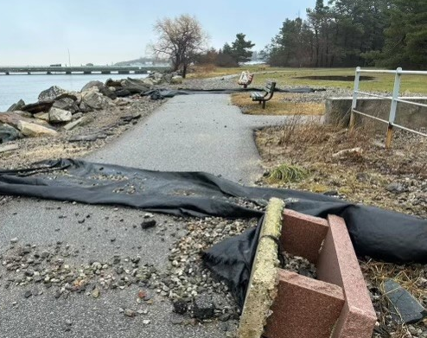
Damage Assessment & Recovery
Bug Light Park
Spring Point Shoreway
Notes:
FD, Parks, DPW and Facilities were all out on 1/14 assessing damage and beginning clear-up and temporary repairs;
Bug Light Park had substantial damage to the paved walkways

Slide 10
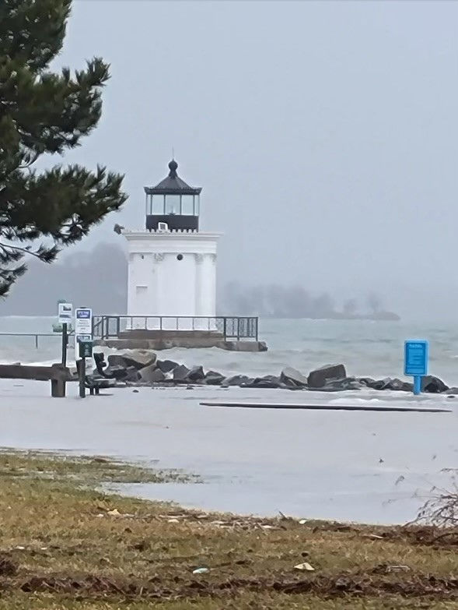
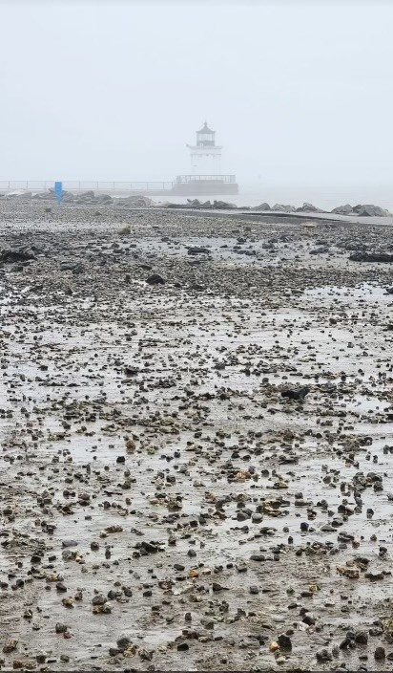
Damage Assessment and Recovery
Bug Light Park
Notes:
Tides inundated areas of the park lowest and closest to the water

Slide 11
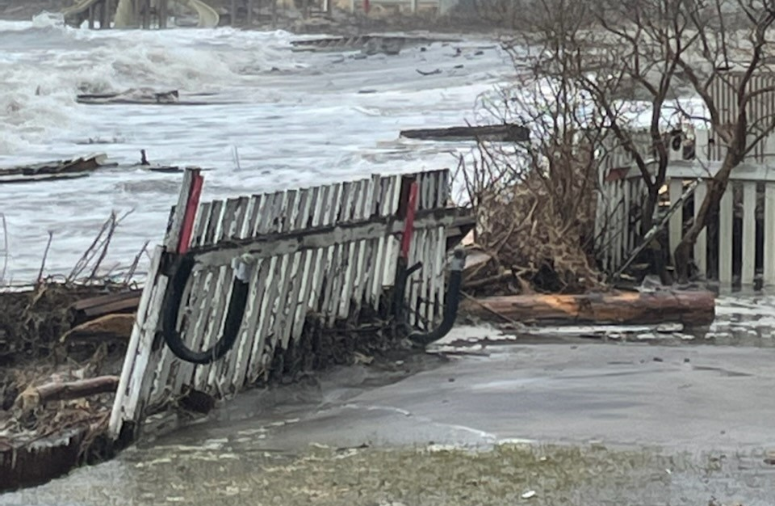
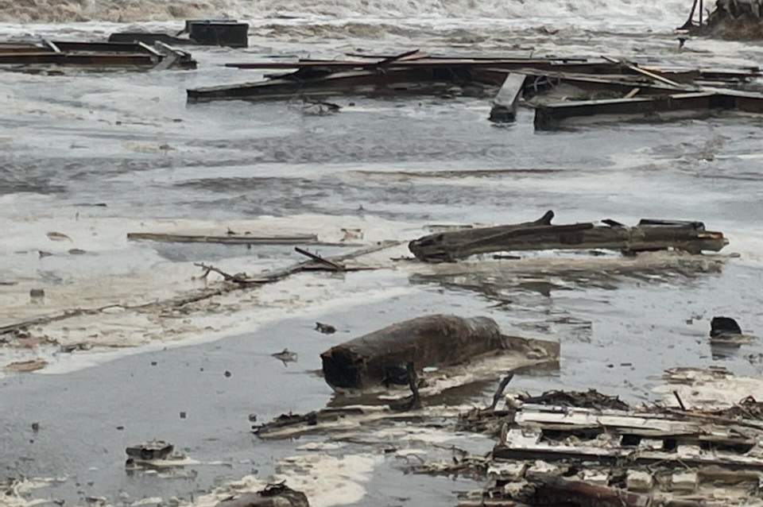
Damage Assessment and Recovery
Willard Beach
Notes:
Debris and storm surge/tides

Slide 12
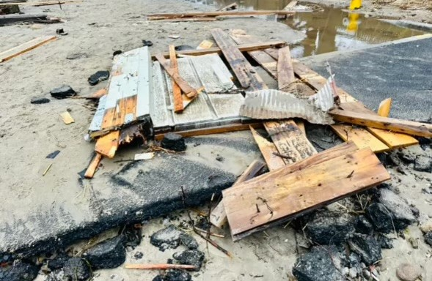
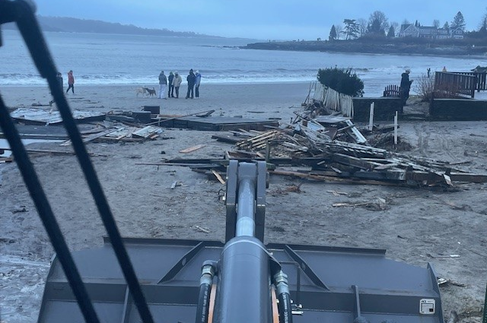
Damage Assessment and Recovery
Willard Beach Myrtle Ave
Notes:
Parks & Public Works Employees were out on Sunday after the storm immediately beginning clean-up

Slide 13
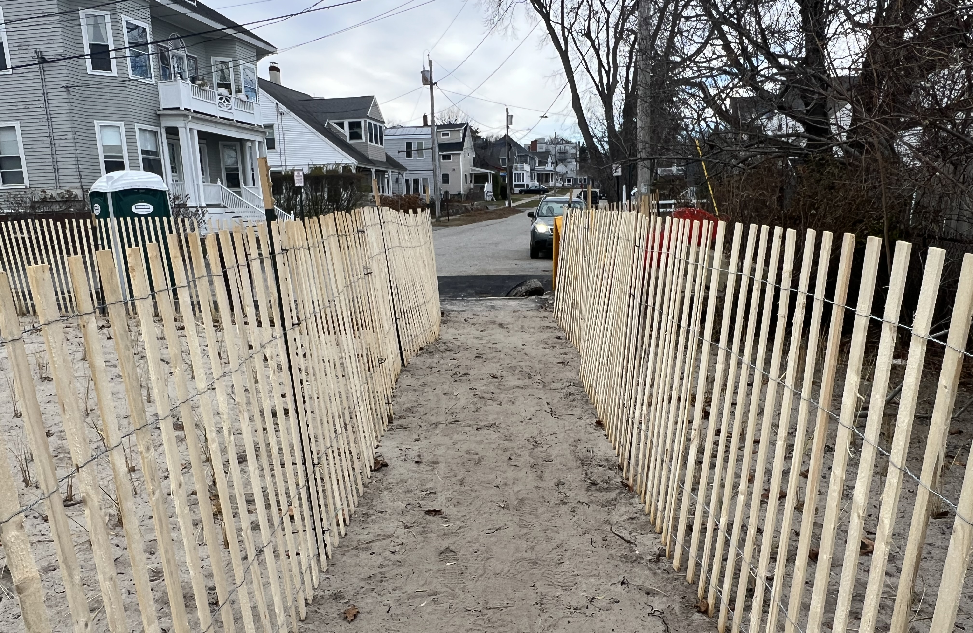
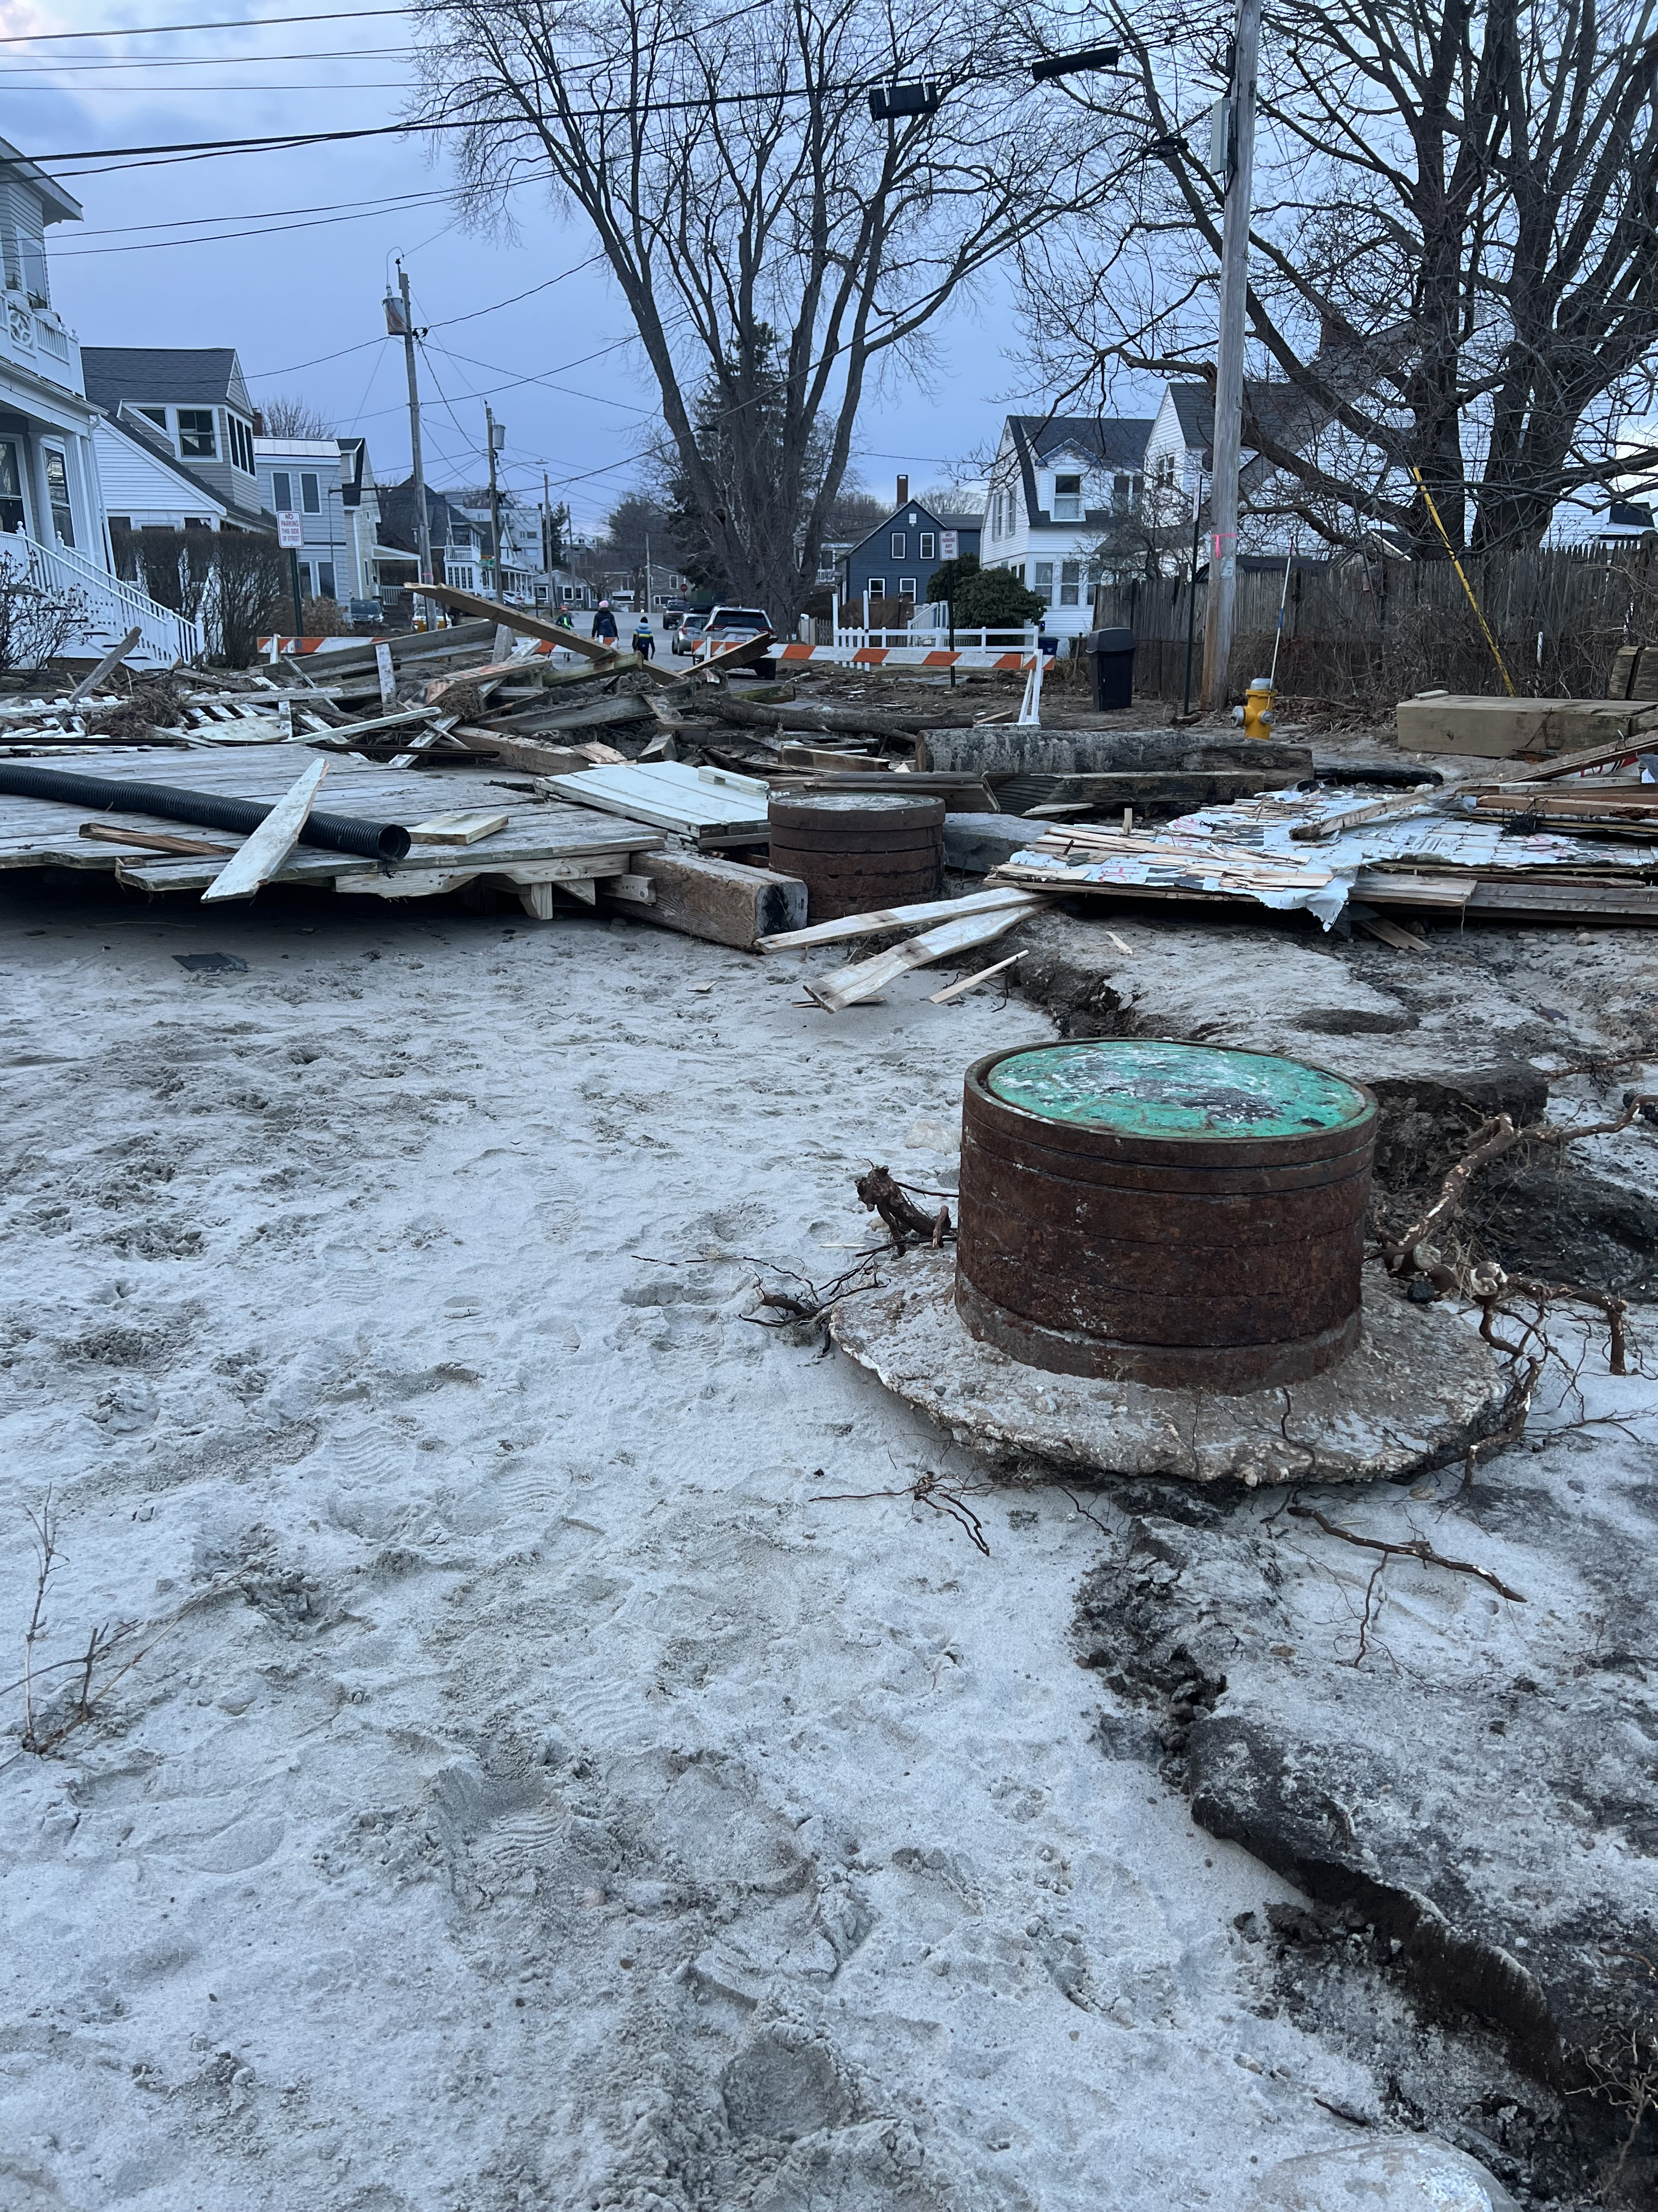
Damage Assessment and Recovery
Willard Beach (Myrle Ave)
Notes:
Before and after Myrtle Ave; Dunes had recently been repaired/restored following a repair to the force main

Slide 14
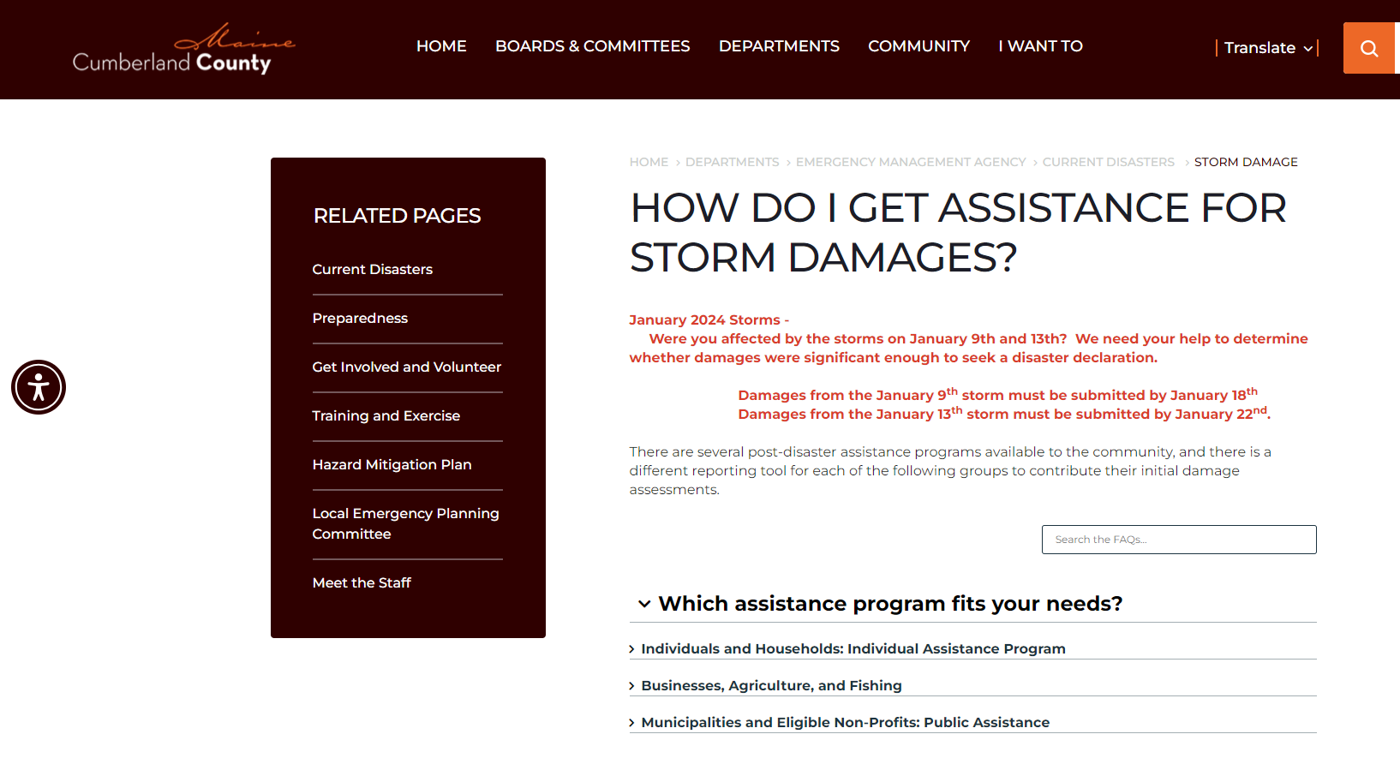
Initial Damage Assessment
Individuals and Households: Individual Assistance Program
Business, Agriculture, and Fishing
Municipalities and Eligible Non-Profits: Public Assistance
Notes:
For the Public Assistance Program, COSP submitted assessment for clean-up efforts and emergency repairs at Bug Light Park;
Clean up at Willard Beach
Replacement of a damaged pump at the Willard Beach Pump Station
And damaged to the dunes that had recently been restored after the Force Main repair at Willard Beach

Slide 15
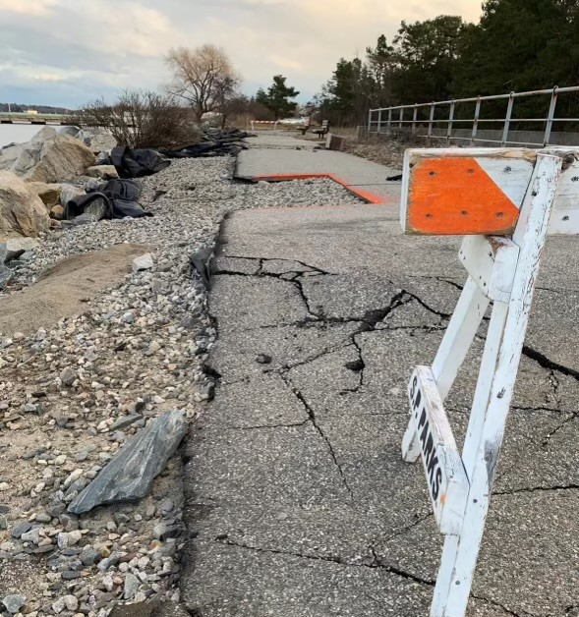
Initial Damage Assessment
FEMA Visit
PA Team Visited
Cumberland County Financial Threshold
Detailed submissions
$160K in damage and wages
Notes:
FEMA Public Assistance Team visited on January 25th;
That group reviewed areas that were impacted and gave guidance on submitting more detailed damage estimates
Those were submitted and now are being reviewed for a FEMA declaration for assistance

